Slide 1
Nuclear Science User Facilities (NSUF) FY 2020 Overview
J. Rory Kennedy, Ph.D.
Director, NSUF
Idaho National Laboratory
FY 2020 NSUF Annual Program Review
BlueJeans Web-based
November 9-10, 2020

Slide 2
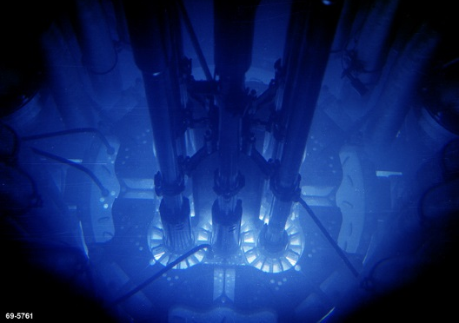
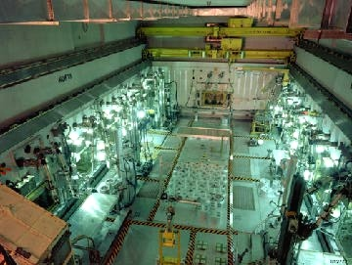
The Nuclear Science User Facilities
Established 2007 as US DOE Office of Nuclear Energy first & only user facility.
Founded at Idaho National Laboratory initially intended as a single institution user facility. INL remains lead and primary institution.
NSUF operates as typical US user facility (no cost to user, competitive proposal processes, no funding to users) but also some unique aspects.
Unique aspects of NSUF
Consortium of facilities/capabilities, not single institution (currently 9 Universities + 4 Universities in CAES, 8 National Laboratories, 1 industry)
NSUF offers multiple capabilities to a single scientific area:
Irradiation effects in nuclear fuels and materials.
Projects can last many years or be short duration.
Largest projects include design, fabrication, transport, irradiation, PIE, and final disposition.
No base funding to facilities.
Funding to facility is for project cost and is fully forward funded.

Slide 3
The Nuclear Science User Facilities
Generally select projects through open competitive proposal processes
Consolidated Innovative Nuclear Research (CINR FOA, 1 call/year)
Irradiation + PIE ($1.0M - $4.0M for neutron, up to 7 years) includes design, analyses, fabrication, transport, irradiation, disassembly, PIE, disposition
PIE only (up to ~$750K and 3 years)
Irradiation with in-situ measurements (up to $3.5M)
Beamlines at other user facilities
Possibility to also receive user R&D funding on limited work scopes
Rapid Turnaround Experiments (RTE, 3 calls/year, limited $$, executed within 9 months)
Proposals welcome from university, government laboratory, industry, and small business researchers. Only non-proprietary projects accepted. All awarded projects are fully forward funded.

Slide 4
Powder Bed Fusion
Nano-modified Concrete
Irradiation Effects in Nuclear Fuels and Materials
Fuel Development
High Performance Computing and Modeling & Simulation
Advanced Manufacturing
Sensor Development
Fundamental Understanding in Reactor Materials
Advanced Cladding and Structural Materials
Radiation Resistant Materials
Model Validation
Welding & Joining
Direct Laser Metal Melting
FeCrAl
Silicon Carbide
MAX Phases
Nanostructured Steels
Irradiation Creep in SiC
ODS Steels
Neutron Absorbing Materials for ATF
Adv. Manufacturing for In-pile Thermal Conductivity
PWR Coolant / U3Si2 Interaction
Optical Fiber / Fused Smart Alloy Sensor by Adv. Manufacture
Accident Tolerant Fuels (ATF) & Cladding
Fission Product Transport in TRISO Fuels
Fiber Bragg Grating Thermometer
FCCI in Metallic Fuels
Piezoelectric and Magnetostrictive Transducer Materials
Ceramic Fuels
Ultra High Burnup
Fission Gas Behavior in Fuels
H Pickup in Zircaloy
RPV Steels Hardening & Embrittlement
Simulating Radiation and Thermal Effects in Cladding
Irradiation Assisted Stress Corrosion Cracking
Irradiation Assisted Grain Growth
Laser Welding
Fast Reactor MOX Annual Fuel
Capacitive Discharge Resistance Welding
Ion – Neutron Irradiation Correlation
SiC - SiC

Slide 5
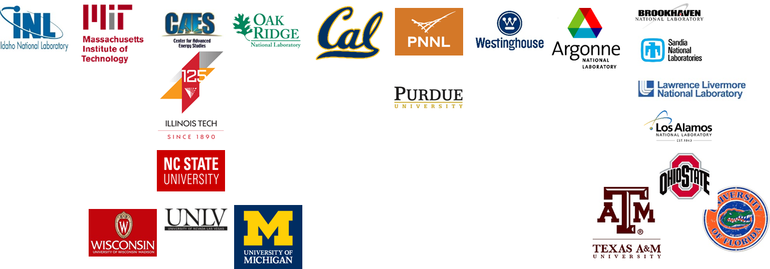












NSUF Capabilities Offer Research Opportunities
Neutron Irradiations | Ion Irradiations | Gamma Irradiations | Hot Cells & Shielded Cells | Low Activity Laboratories | Beamlines | High Performance Computing
INL +
9 Universities
CAES (4 Univ)
7 National Labs
1 Industry
1 Int’l Affiliate
Visit nsuf.inl.gov for details at individual facilities

Slide 6
FY 2020 NSUF Support Structure Points of Contact
DOE
Ms. Alice Caponiti
Mr. Mike Worley
Ms. Suibel Schuppner
Ms. Tansel Selekler
Ms. Willettia Amos (ID)
Mr. Jihad Aljayoushi (ID)
Neutron Irradiation
Ms. Debra Utterbeck (INL)
Dr. Gordon Kohse (MIT)
Mr. Kory Linton (ORNL)
Prof. Raymond Cao (OSU)
Prof. Ayman Hawari (NCSU)
Dr. Richard Sisson (SNL)
Dr. Sven Van den Berghe (BNRC)
Examinations
Mr. Kory Linton (ORNL)
Dr. Yaqiao Wu (CAES)
Dr. Andrew Casella (PNNL)
Prof. Ahmed Hassanein (Purdue)
Prof. Peter Hosemann (UCB)
Mr. Mike Ickes (Westinghouse)
Dr. Tarik Saleh (LANL)
Prof. James Baciak (UFla)
Prof. Kumar Sridharan (UW)
Prof. Ayman Hawari (NCSU)
Prof. Gary Was (UM)
Dr. Mitch Meyer (INL)
Dr. Sven Van den Berghe (BNRC)
Ion Beams
Dr. Meimei Li (IVEM, ANL)
Prof. Gary Was (UM)
Prof. Kumar Sridharan (UW)
Dr. Khalid Hattar (SNL)
Prof. Lin Shao (TAMU)
Dr. Scott Tumey (LLNL)
Beamlines
Dr. Lynne Ecker (BNL)
Prof. Ayman Hawari (NCSU)
Dr. Tarik Saleh (LANL)
And many more scientists, engineers and technical staff at INL and all partner facilities to help get things done

Slide 7
NSUF Personnel FY 2020 Update
DOE
Alice Caponiti, Deputy Assistant Secretary of Energy
Suibel Schuppner, Office of Nuclear Energy Technologies Director
Vacant, National Laboratory and Industry Capabilities Team Leader (filled by Melissa Bates in FY 2021)
Staff
Jonathan Kirkham left
Rachel Jones new Planning and Financial Controls Specialist (PFCS)
Travis Howell left as PFCS but is new Experiment Manager
John Coody left, E. K. Stosich temporary, William McClung permanent

Slide 8
NSUF Organization Chart

Slide 9
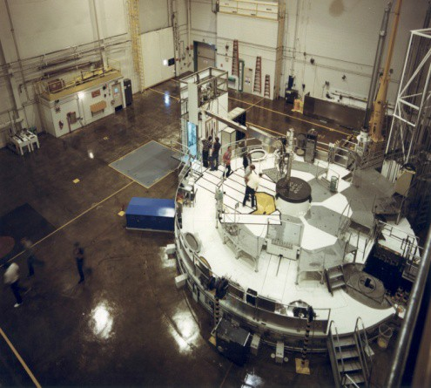
NSUF Projects Summary
FY 2007 – FY2020*
Total of 43 CINR type projects executed
Total of 48 CINR type projects currently ongoing
Total of 398 RTEs executed
Total of 90 RTEs ongoing
579 total projects awarded
359 projects to 51 US universities
167 projects to 7 national laboratories
22 projects to 9 industry
31 projects to 17 international (Oxford U., Manchester U., Liverpool U., Bristol U., Sheffield U., Huddersfield U., Sabanci U., Queens U., Leoben U., NNL, ANSTO, CEA Saclay, Institutio Italiano di Technologia, SCK-CEN, EC-JRC-Karlsruhe, Studsvik Nuclear, Canadian Nuclear Laboratories)
FY 2020
Effective FY2020 budget: ~$12M (vs ~$30M FY16 – FY19)
Total effective FY 2020 budget allocated to projects: ~$6.2M direct (CINR + RTE) + ~$3M supporting (PIE coordination, experiment managers, experiment analyses, shipping, SCK-CEN pilot projects)
At any particular time, NSUF is typically managing ~100 – 130 projects
* As of 9/2020

Slide 10
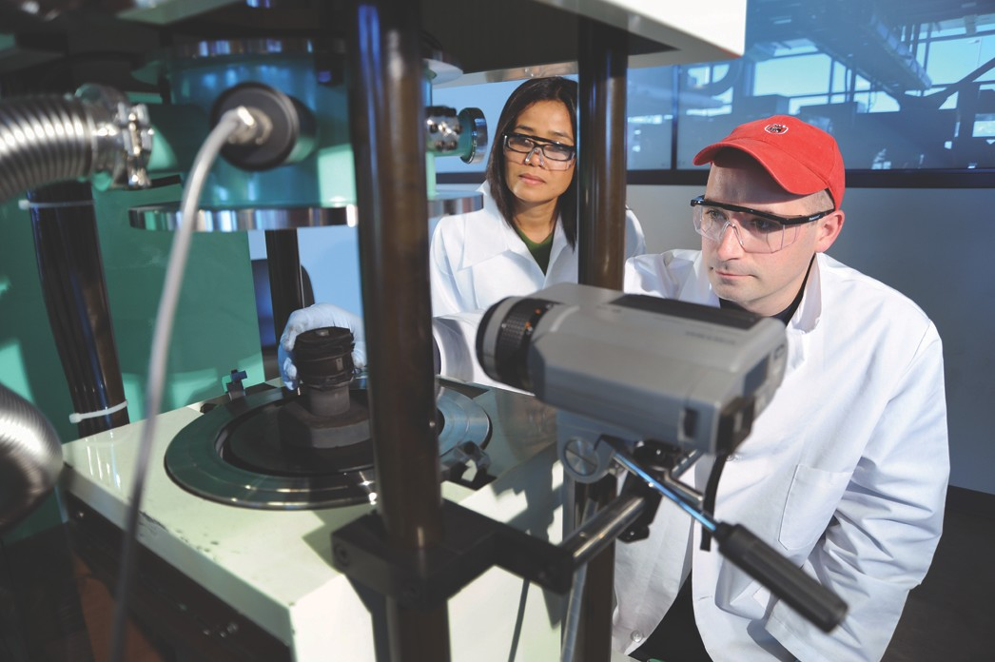
FY 2020 Highlights
Completed 12/13 Level 2 Milestones On or Ahead of Schedule (1 missed due to COVID).
Record Number of Publications (2019) h-index at 9/30/2020 = 27.
Completed 75/99 RTEs (75%).
Completed One CINR Project.
Six Experiments into Reactor (1 ATR, 1 NRAD, 1 OSURR, 3 HFIR).
Completed Eight Irradiations (2 ATR, 1 NRAD, 2 MITR, 2 HFIR, 1 OSURR).
Completed Final Design Reviews on Three ATR Irradiations and One TREAT Irradiation.
2 NSUF Sessions at ANS 2019 Winter Meeting and 2 NSUF Sessions at ANS 2020 Annual Meeting.
Sawtooth Supercomputer Received and Opened to Users .
Nuclear Materials Discovery and Qualification Initiative Launched.
Deployed the Reactor Activation and Decay (RAD) Calculator.
Awarded 56 RTEs.
Awarded 8 CINR Projects.
Deployed CoMET with Nuclear Experiment Wizard Expert System.
Received the BRR Cask Trailer.
Funded the Activated Materials Laboratory at the Advanced Photon Source.
7

Slide 11
FY 2020 Milestones
Completed 11 of 12 level 2 milestones on or ahead of schedule
Complete Progress Report on the Application of the FaMUS Methodology to the NSUF Research Portfolio – 10/31/2019 (10/31/2019)
Hold FY 2019 Annual Program Review - 11/25/2019 (12/19/2019)
Submit to DOE the NSUF RTE Award Recommendations for the FY 2020 1st Call - 1/15/2020 (1/15/2020)
Submit FY 2019 Annual Report for HPC Operations and Accomplishments – 3/30/2020 (3/30/2020)
Submit to DOE the NSUF FY 2019 Annual Report – 4/7/2020 (4/7/2020)
Turn Sawtooth Over to Users 3/18/2020 (5/1/2020)
Submit to DOE the NSUF RTE Award Recommendations for the FY 2020 2nd Call – 624/2020 (6/30/2020)
Submit FY 2020 Gap Analysis – 6/24/2020 (6/30/2020)
Submit to DOE a Spreadsheet Summarizing FY 2020 CINR Award Recommendations for NSUF Access – 6/18/2020 (7/2/2020)
Prepare and Deliver an Online HPC Training Program to Support New Users - 7/10/2020 (7/30/2020)
Complete 3-Year NMDQi Roadmap for Capability Development – 9/23/2020 (9/30/2020)
Complete 85% of the FY 2019 awarded RTE's - (9/30/2020)
Completed 37 of 57 level 3 milestones on or ahead of schedule
COVID-19 had significant effect on facility shutdowns and personnel resources.
7

Slide 12
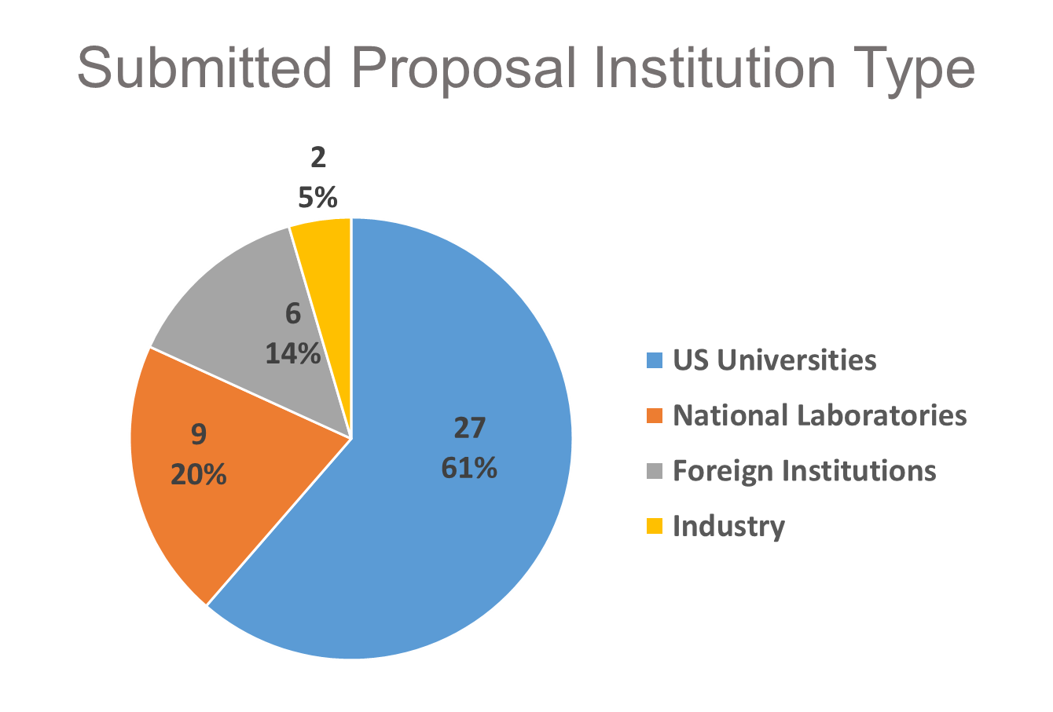
FY 2020 Highlights
Awards Valuation of $2.4M
Rapid Turnaround Experiments
168 proposals submitted from 44 institutions (185/51 in FY19)
27 US Universities
9 National Laboratories
6 Foreign Institutions
2 Industry
56 experiments awarded PIs from 29 institutions (99/38 in FY19)
34 US Universities
16 National Laboratories
4 Foreign Institutions
2 Industry
14 NSUF facilities performed experiments (12 in FY19)
16 Idaho National Laboratory
10 Center for Advanced Energy Studies (CAES)
9 Argonne National Laboratory / IVEM
8 Oak Ridge National Laboratory / LAMDA
4 University of Michigan
2 Brookhaven National Laboratory
2 The Ohio State University
2 Texas A&M University
2 Sandia National Laboratory
2 Pacific Northwest National Laboratory
2 Massachusets Institute of Technology
1 University California, Berkeley
1 North Carolina State University
2 Los Alamos National Laboratory

Slide 13
Interest and Support Continue to Grow
$10M
~$11M
$16M
$4M
~$11M
*
CINR type project new award funding levels
CINR type project new award funding levels
$16M
$10M
$10M
$10M
$4.1M
$4.1M
$400K
~$6M
~$5M
~$3M
~$4M
$400K
~$6M
~$5M
~$3M
~$4M
* Only 2 RTE solicitations in FY 2020
Graphics created by Brenden Heidrich

Slide 14
CINR Awarded Projects
Focus on Key Technologies and Understanding
Additive / Advanced Manufacturing
CINR Awarded Projects table created by Lindy Bean

Slide 15
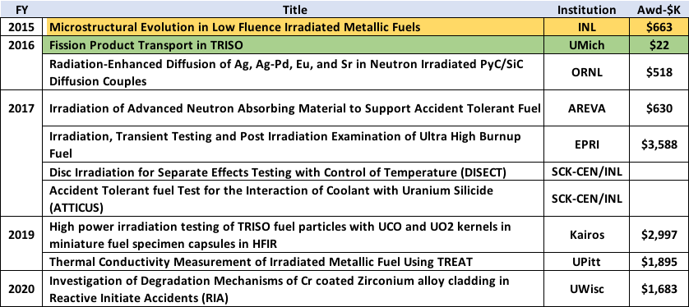
CINR Awarded Projects
Focus on Key Technologies and Understanding
Advanced Fuel Development
CINR Awarded Projects table created by Lindy Bean

Slide 16
CINR Awarded Projects
Focus on Key Technologies and Understanding
Fundamentals for Reactor Materials
CINR Awarded Projects table created by Lindy Bean

Slide 17
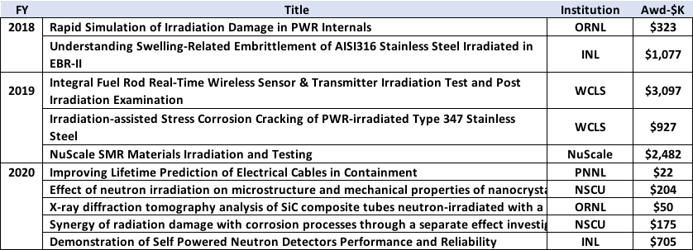
CINR Awarded Projects
Focus on Key Technologies and Understanding
Fundamentals for Reactor Materials continued
Welding and Joining Advanced Cladding
CINR Awarded Projects table created by Lindy Bean

Slide 18
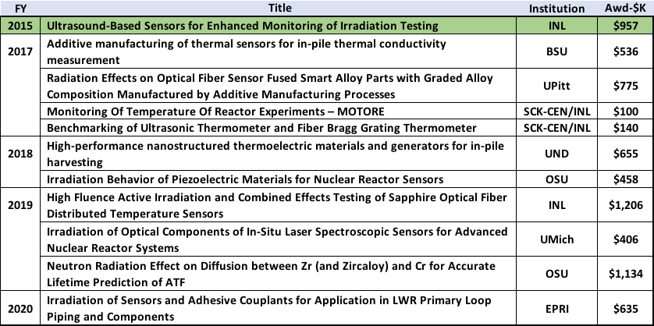
CINR Awarded Projects
Focus on Key Technologies and Understanding
Sensor Development
CINR Awarded Projects table created by Lindy Bean

Slide 19
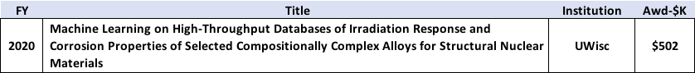
CINR Awarded Projects
Focus on Key Technologies and Understanding
Computational Model Development and Validation
Nuclear Materials Discovery & Qualification Initiative
CINR Awarded Projects table created by Lindy Bean

Slide 20
CINR Awarded Projects FY 2015 – FY 2020
Graphics created by Simon Pimblott

Slide 21
CINR Awarded Projects FY 2015 – FY 2020
Graphics created by Simon Pimblott

Slide 22
NSUF Publications
Numbers are for calendar years
Increase in RTE awards through FY 2019.
H-index score of 27 (score of 17 to 9/2019)
Journal of Nuclear Materials is by far the journal of choice.

Slide 23
FY 2020 Accomplishments
NSUF reporting presentations or participation
Nuclear Engineering Department Head Organization Meetings – NEDHO (November 2019)
US-UK Nuclear Energy R&D Collaboration Action Plan Steering Committee Meeting (November 2019)
NSUF FY 2019 Annual DOE Program Review Meeting (November 2019)
DOE FY 2020 1st Quarter Review (February 2020)
NSUF Users/Partners Meeting (February 2020)
DOE Strategic Planning Meeting (June 2020)
DOE FY 2020 2nd Quarter Review (June 2020)
Nuclear Engineering Department Head Organization Meeting – NEDHO (June 2020)
DOE Budget Planning Meeting #1 (July 2020)
DOE Budget Planning Meeting #2 (August 2020)
UK Nuclear Academics Discussion Meeting – via (September, 2019)

Slide 24
FY 2020 Accomplishments
NSUF general presentations, exhibits, or special invitations
ANS Winter Meeting (November 2019) – exhibit, presentations, and 2 NSUF sessions
GAIN Legacy Metallic Fuels Meeting (November 2019)
MRS Fall Meeting (December 2019) – exhibit
TMS Annual Meeting (February 2020) – exhibit
ANS Annual Meeting (June 2020) – 2 NSUF Sessions
10

Slide 25
FY 2020 Accomplishments
Neutron Irradiation Activities
Static Capsule Irradiation Experiments
Completed irradiations FY 2020:
ISU-10537 - 2 dpa N-SERT (Nano-structured Steels for Enhanced Radiation Tolerance) – “Enhancing Irradiation Tolerance of Steels via Nanostructuring by Innovative Manufacturing Techniques” (ATR)
BSU-8242 – 3 dpa “Irradiation Influence on Alloys Fabricated by Powder Metallurgy and Hot Isostatic Pressing for Nuclear Applications” (ATR)
INL-16380 – “High Fluence Active Irradiation and Combined Effects Testing of Sapphire Optical Fiber Distributed Temperature Sensors” (OSURR)
GA-12573 – “Performance of SiC-SiC Cladding and Endplug Joints Under Neutron Irradiation with a Thermal Gradient” (HFIR)
PITT-KC-13073 – “Radiation Effects on Optical Fiber Sensor Fused Smart Alloy Parts with Graded Alloy Composition Manufactured by Additive Manufacturing Processes” (MITR)
BSU-YZ-12527 – “Additive Manufacturing of Thermal Sensors for In-Pile Thermal Conductivity Measurement” (NCSU & MITR)
MIT-14783 – “Nanodispersion Strengthened Metallic Composites with Enhanced Neutron Irradiation Tolerance” (HFIR)
12

Slide 26
FY 2020 Accomplishments
Neutron Irradiation Activities
Static Capsule Irradiation Experiments con’t.
Reactor insertion irradiations FY 2020:
ATAMM (Aeroprobe Test of Additively Manufactured Materials) – 14788 “Irradiation Testing of Materials Produced by Additive Friction Stir Manufacturing” (ATR)
INL-16380 “High Fluence Active Irradiation and Combined Effects Testing of Sapphire Optical Fiber Distributed Temperature Sensors” (OSURR)
AREVA-13007 “Irradiation of Advanced Neutron Absorbing Material to Support Accident Tolerant Fuel” (HFIR)
GA-12573 – “Performance of SiC-SiC Cladding and Endplug Joints Under Neutron Irradiation with a Thermal Gradient” (HFIR)
MIT-14783 – “Nanodispersion Strengthened Metallic Composites with Enhanced Neutron Irradiation Tolerance” (HFIR)
RTE-2828 – “Irradiation of Nb-93 targets for ASTM International Inter- Laboratory Study of E1297, "Standard Test Method for Measuring Fast-Neutron Reaction Rates by Radioactivation of Niobium".” (NRAD)
On-going irradiations FY 2020:
EPRI-ZG-C & EPRI-ZG-D – “Irradiation and Post-irradiation Examination (PIE) to Investigate Hydrogen Assisted Anomalous Growth in Zirconium Alloys” (ATR)
BSU-269 – “High Temperature In-pile Irradiation Test of Single Phase U3Si2” (ATR)
ISU-10537 – 6 dpa N-SERT - “Enhancing Irradiation Tolerance of Steels via Nanostructuring by Innovative Manufacturing Techniques” (ATR)
OSU-MK-14749 – “Irradiation Behavior of Piezoelectric Materials for Nuclear Reactor Sensors” (OSURR)
12

Slide 27
FY 2020 Accomplishments
Post Irradiation Examination (PIE) Activities
Completed PIE Activities FY 2020:
UI-JS PIE-17-13211 – “Positron Annihilation Studies of Neutron Irradiated Ferritic Alloys” (NCSU, INL)
Ongoing PIE Activities FY 2020:
EPRI -1, -2, and -3 – “EPRI Pilot Project for Irradiation of Alloys X-750 and XM-19” CRADA (INL)
BSU-8242 – “Irradiation Influence on Alloys Fabricated by Powder Metallurgy and Hot Isostatic Pressing for Nuclear Applications” 1 dpa (INL)
CSM-JK-10584 – “Irradiation Performance Testing of Specimens Produced by Commercially Available Additive Manufacturing Techniques” (INL)
ORNL-TG-10764 – “Radiation Enhanced Diffusion of Ag, Ag-Pd, Eu and Sr in Neutron Irradiated PyC/SiC Diffusion Couples“ (ORNL)
ISU-HW-10537 – “Enhancing Irradiation Tolerance of Steels via Nanostructuring by Innovative Manufacturing Techniques” (INL)
GEH-RH-10393 – “Irradiation Testing of LWR Additively Manufactured Materials”(INL)
INL-JH PIE-17-12976 – “Study of the Irradiation Behavior of Fast Reactor Mixed Oxide Annular Fuel with Modern Microstructural Characterization to Support Science Based Model Validation”
Westinghouse PX-17-13106 – “Radiation Effects on Zirconium Alloys Produced by Powder Bed Fusion Additive Manufacturing Processes” (WEC)
12

Slide 28
FY 2020 Accomplishments
Post Irradiation Examination (PIE) Activities
Ongoing PIE Activities FY 2020:
ORNL-LT-17-13050 – “Correlation between Microstructure and Mechanical Properties of Neutron-Irradiated Ferritic-Martensitic and Austenitic Steels” (ORNL, INL, LANL)
PITT-KC-13073 – “Radiation Effects on Optical Fiber Sensor Fused Smart Alloy Parts with Graded Alloy Composition Manufactured by Additive Manufacturing Processes” (WEC)
WEC-PX-13106 – “Radiation Effects on Zirconium Alloys Produced by Powder Bed Fusion Additive Manufacturing Processes” (WEC)
EPRI-AK-13088 – “Improved Understanding of Zircaloy-2 Hydrogen Pickup Mechanism in BWRs” (ORNL)
FLA-AA-14704 – “Facilitating MARMOT Modeling of Radiation Phenomena in U-Pu-Zr fuels through experiments (MORPH experiment)” (INL)
ORNL-KF-14717 – “Rapid Simulation of Irradiation Damage in PWR Internals” (CAES, ORNL, UMich)
INL-CS-14772 – “Understanding Swelling-Related Embrittlement of AISI316 Stainless Steel Irradiated in EBR-II” (INL, CAES, WEC)
PNNL-RP-14787 – “High-dose ion irradiation testing and relevant post-irradiation examination of friction-stir-welded ODS MA956 alloy” (INL, CAES, TAMU)
WEC-MI-16567 – “Irradiation-assisted Stress Corrosion Cracking of PWR-irradiated Type 347 Stainless Steel” (UMich, WEC)
12

Slide 29
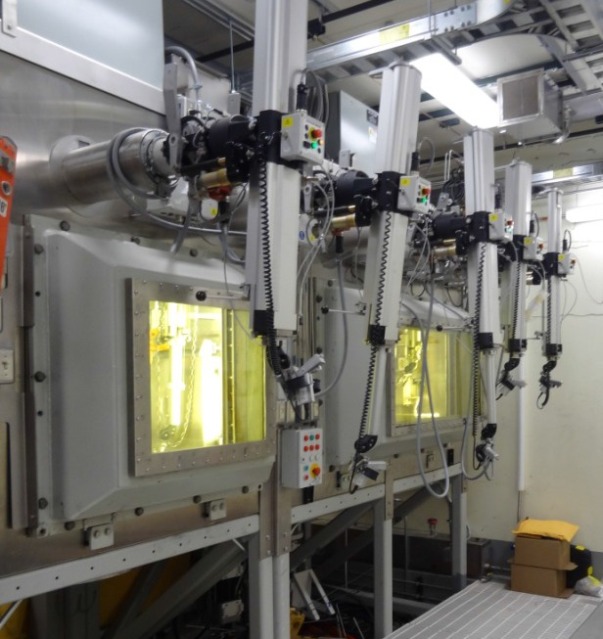
FY 2020 Accomplishments
Industry Programs
CINR shows good industry interest and RTE interest is “average”
FY 2014: 0 RTE apps, 0 CINR type pre-apps
FY 2015: 0 RTE apps, 1 CINR pre-apps, 0 CINR full apps, 0 awarded
FY 2016: 1 RTE app, 4 CINR pre-apps, 2 CINR apps, 1 awarded
FY 2017: 7 RTE apps, 13 PI CINR pre-apps, 6 PI CINR apps, 12 co-PI CINR apps, 5 awarded
FY 2018: 6 RTE apps, 8 PI CINR acc req, 2 PI CINR apps, 7 co-PI apps, 1 awarded
FY 2019:
0 RTE applications
11 industry PI CINR pre-apps (EPRI, NuScale, Westinghouse, Kairos, Optomec, BTech Acoustics)
20 industry co-PI pre-apps
6 industry PI CINR full applications (EPRI, NuScale, Westinghouse, Kairos)
9 industry co-PI full applications
4 industry PI CINR awarded (NuScale, Westinghouse, Kairos)
3 industry co-PI awarded
FY 2020:
3 RTE applications
11 industry PI CINR pre-apps (EPRI, Westinghouse, General Atomics, General Electric, Moltex Energy, Free Form Fibers)
26 industry co-PI pre-apps (includes industry co-PI on industry PI pre-app)
4 industry PI CINR full applications (EPRI, Westinghouse, General Atomics)
13 industry co-PI full applications
1 industry PI CINR awarded (EPRI)
2 industry co-PI awarded

Slide 30
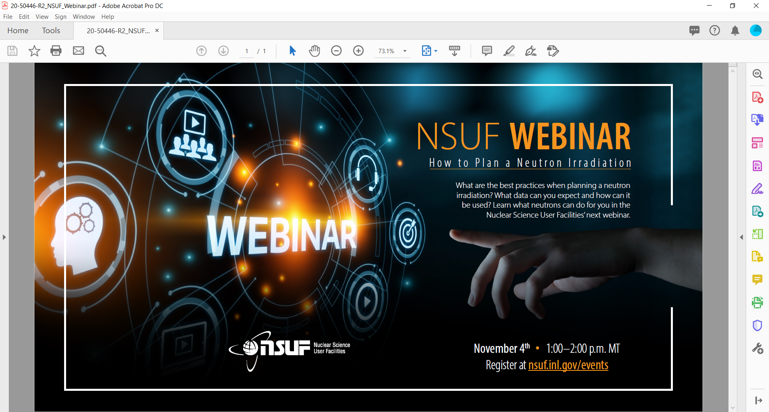
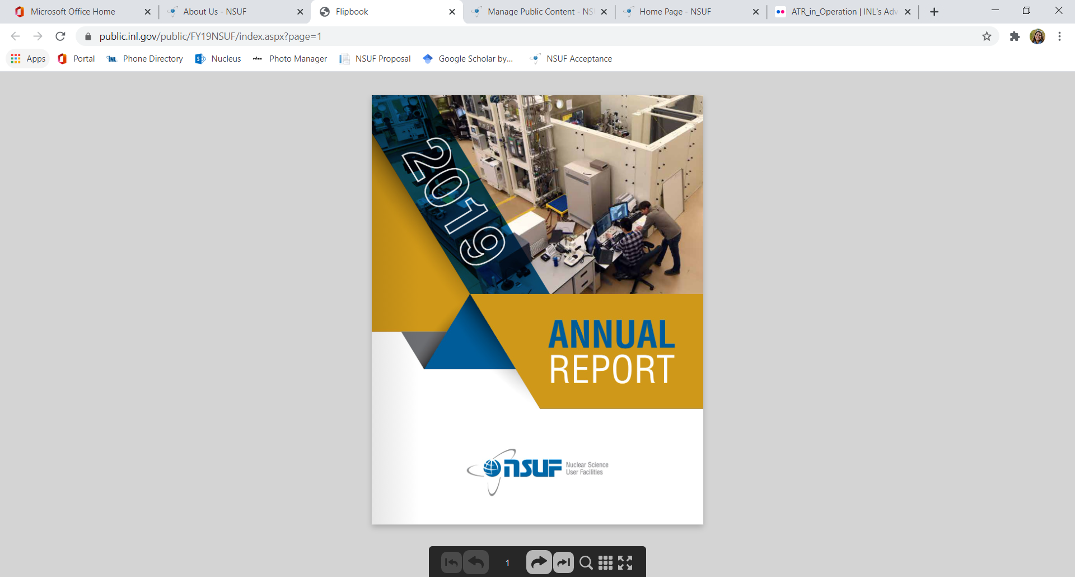
FY 2020 Accomplishments
Communications
Promotion
Very successful (applications and partner applications)
Branding
Initiated Webinar Series
News Letter (started in 2019, very successful)
Updated NSUF factsheet
Annual Report
Metrics – all but one metric met
Efficient use of funding for new awards
>50% funding to new awards (23%)
Effective use of NSUF capabilities
>20% funding to partner facilities (>47%)
Publications and presentations
>20 peer reviews articles or presentation proceedings (>90)
Prominence and positive exposure for NSUF
Invited lectures, etc. 5% increase per year
Expand and diversify NSUF user community
Analyze data and act on trends
High Performance Computing
Supported at 100% in FY 2020 with $10M
New supercomputer Sawtooth acquired and deployed
NE-5 usage good at >150M core hours but NSUF direct usage low at ~2M core hours
Support as-run, thermal, neutronics, and structural analyses
Moose-Bison-Marmot (MBM) support

Slide 31
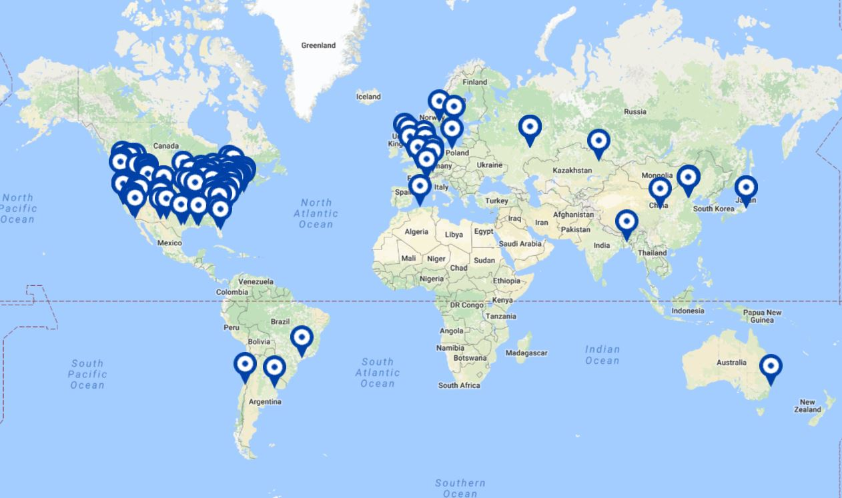
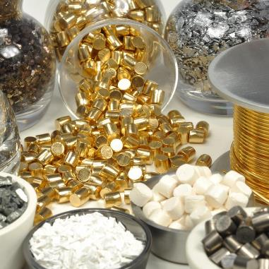
FY 2020 Accomplishments
Infrastructure / Capabilities Management
Nuclear Energy Infrastructure Database (NEID) updating/expansion paused (lost personnel)
150 institutions, ~500 facilities, ~1000 instruments
80% US domestic, 20% international
NSUF runs the Research Reactor Upgrades and General Scientific Infrastructure FOAs since FY 2017
Gap Analysis – informs DOE FOAs and National Laboratory capability investments
Combined Materials Experiment Toolkit (CoMET) launched with Wizard and RAD calculator
Nuclear Fuels and Materials Library (NFML)
NFML application and user interface improved in FY 2019.
NFML database use up.
NFML materials requests down slightly.
NFML materials inventory up.
Significant number of materials/fuels sources under consideration/negotiation.
Continued effort on linking NFML to other NSUF, national, and international databases.

Slide 32
International Collaborations
DOE-NE / NSUF and UK / National Nuclear User Facility (NNUF).
DOE-NE and NSUF invited to Nuclear Academics Discussion Meetings.
Initial area of mutual user facility interest and cooperation.
Nuclear Fuels and Materials Library (Archive).
US – UK Nuclear Energy R&D Cooperative Action Plan (signed Sept 2018).
Enabling Technologies Working Group
University Engagement – DOE (NEUP) & EPSRC.
National User Facilities – NSUF & NNUF (facility sharing).
Resource Libraries - NEID, NFML, NERD, etc.
Public Engagement.
Steering Committee Meeting held November 2019.
NSUF Nuclear Fuels and Materials Library working with the UK Irradiated Materials Archive Group (IMAG).
NSUF program office working with NNUF Management Group on potential joint projects and other areas of collaboration.
Eighteen RTE awards to UK researchers and eight NSUF acknowledged UK researcher publications since Action Plan signed.
Four NSUF CINR projects awarded with UK collaborators.
NSUF invited to Nuclear Academics Discussion Meetings.

Slide 33
International Collaborations
DOE-NE / NSUF / INL and SCK-CEN / BR2 / LHMA
MOU with DOE, CRADA with INL
In-kind contributions
CRADA with four tasks
Monitoring Of Temperature Of Reactor Experiments MOTORE – completed.
Disc Irradiation for Separate Effects Testing with Control of Temperature (DISECT) – ongoing.
Accident Tolerant fuel Test for the Interaction between Coolant and Uranium Silicide (ATTICUS) – postponed.
Cooperative In-Pile Instrumentation Development - ongoing
DISECT & In-pile Instrumentation
Experiment is on U-Zr and U-Mo fuels.
Fabricated hardware (capsule components), fuels and pucks, instrumentation.
Tentative plan to ship at least U-Zr experiment in 3rd or 4th quarter FY 2021 but COVID has disrupted schedule and there are priority issues for final welding and assembly.
Hold Steering Committee Meeting at time of shipment in Belgium.
US: NE-5 Deputy Assistant Secretary (Alice Caponiti), INL NS&T Associate Laboratory Director (John Wagner), NSUF Director (Rory Kennedy)
Belgium: Director-General BNRC (Eric van Walle), Managing Director BNRC (Sven van den Berghe), Stakeholder Manager SCK-CEN (Joris Van den Bosch)
Shipping details currently being worked.

Slide 34
NSUF Facility Utilization - CINR
CAES MaCS is a partner facility but not included in CINR analysis since supported on annual basis.
CINR total partner funding generally increased since FY 2014 until FY 2020.
Lower FY 2018 partner funding due to higher number of ATR irradiations.
Graphics created by Alison Conner

Slide 35
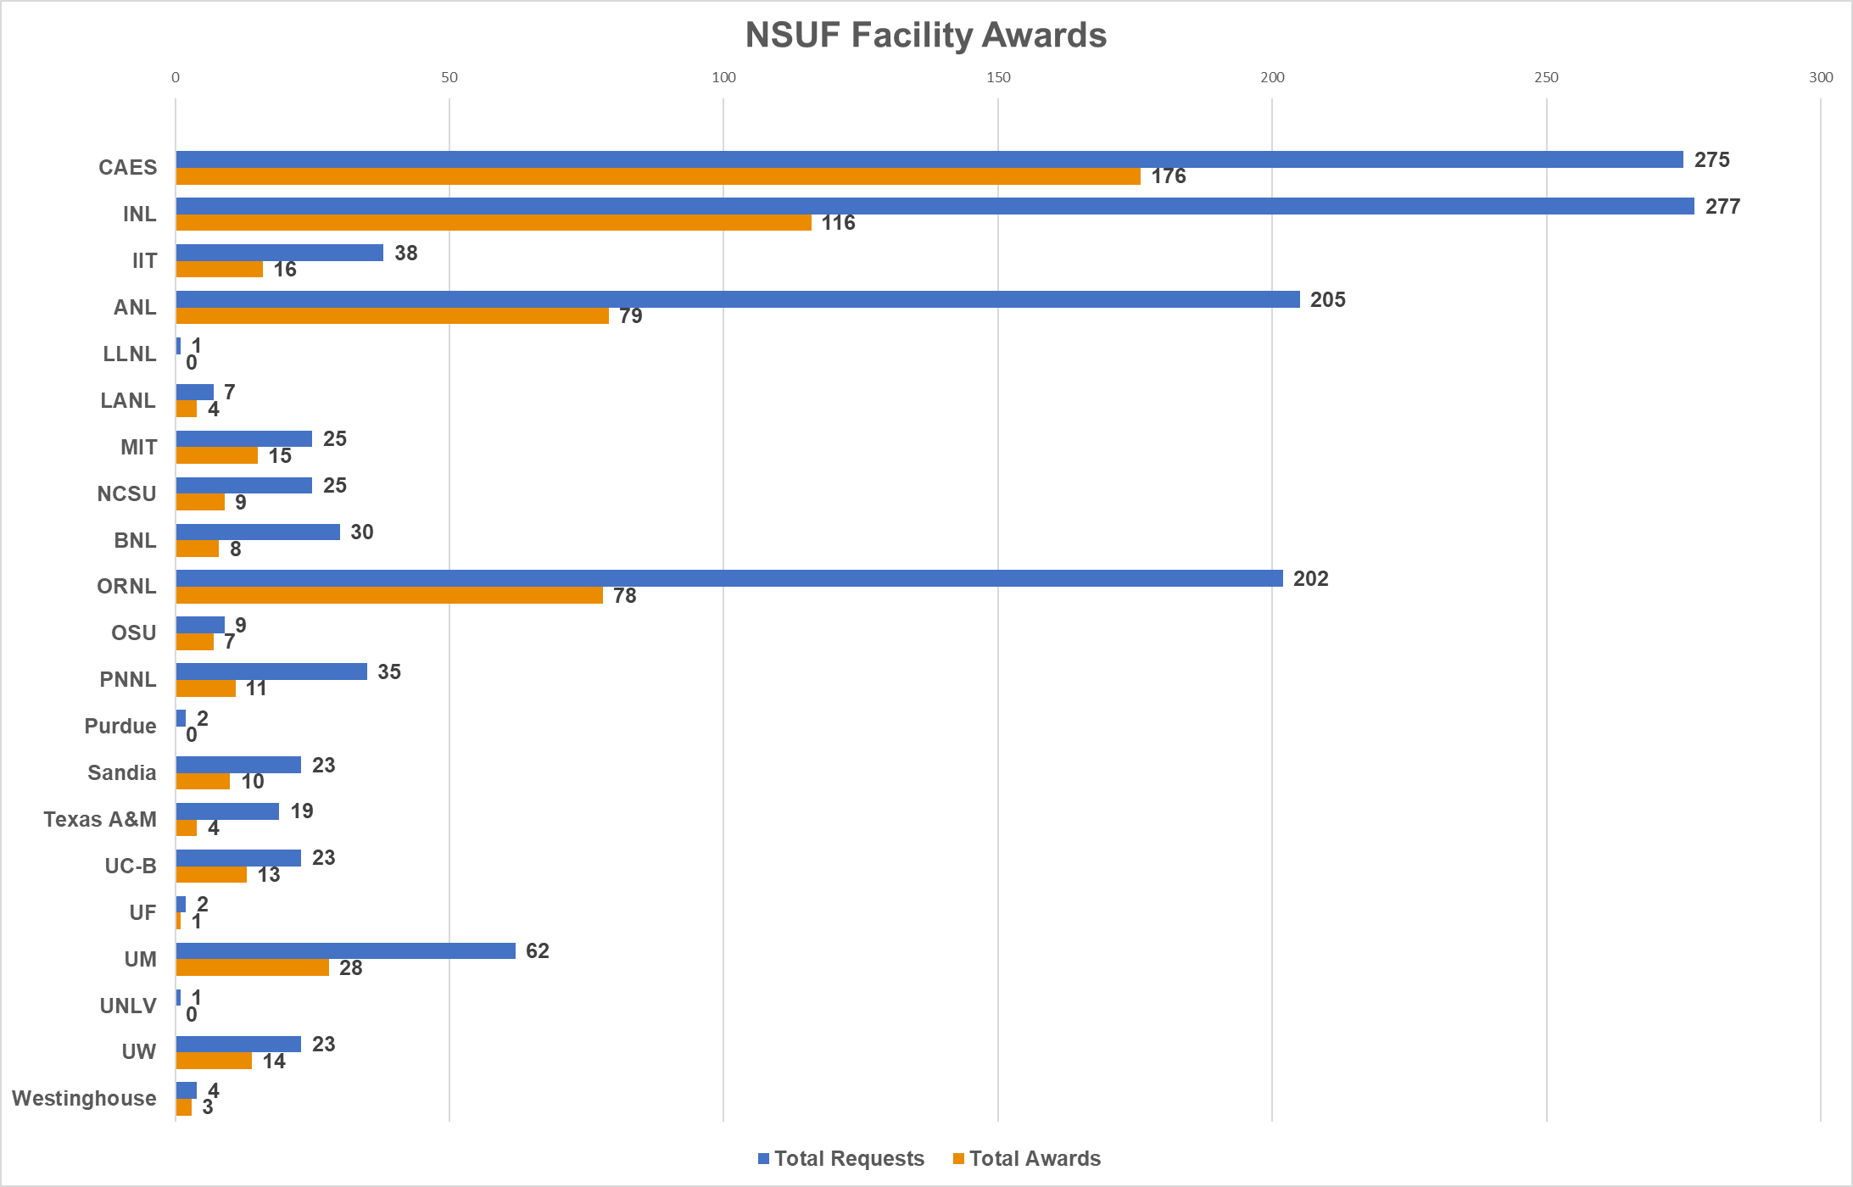
NSUF Facility Utilization - RTEs
Graphics created by Jeff Benson

Slide 36
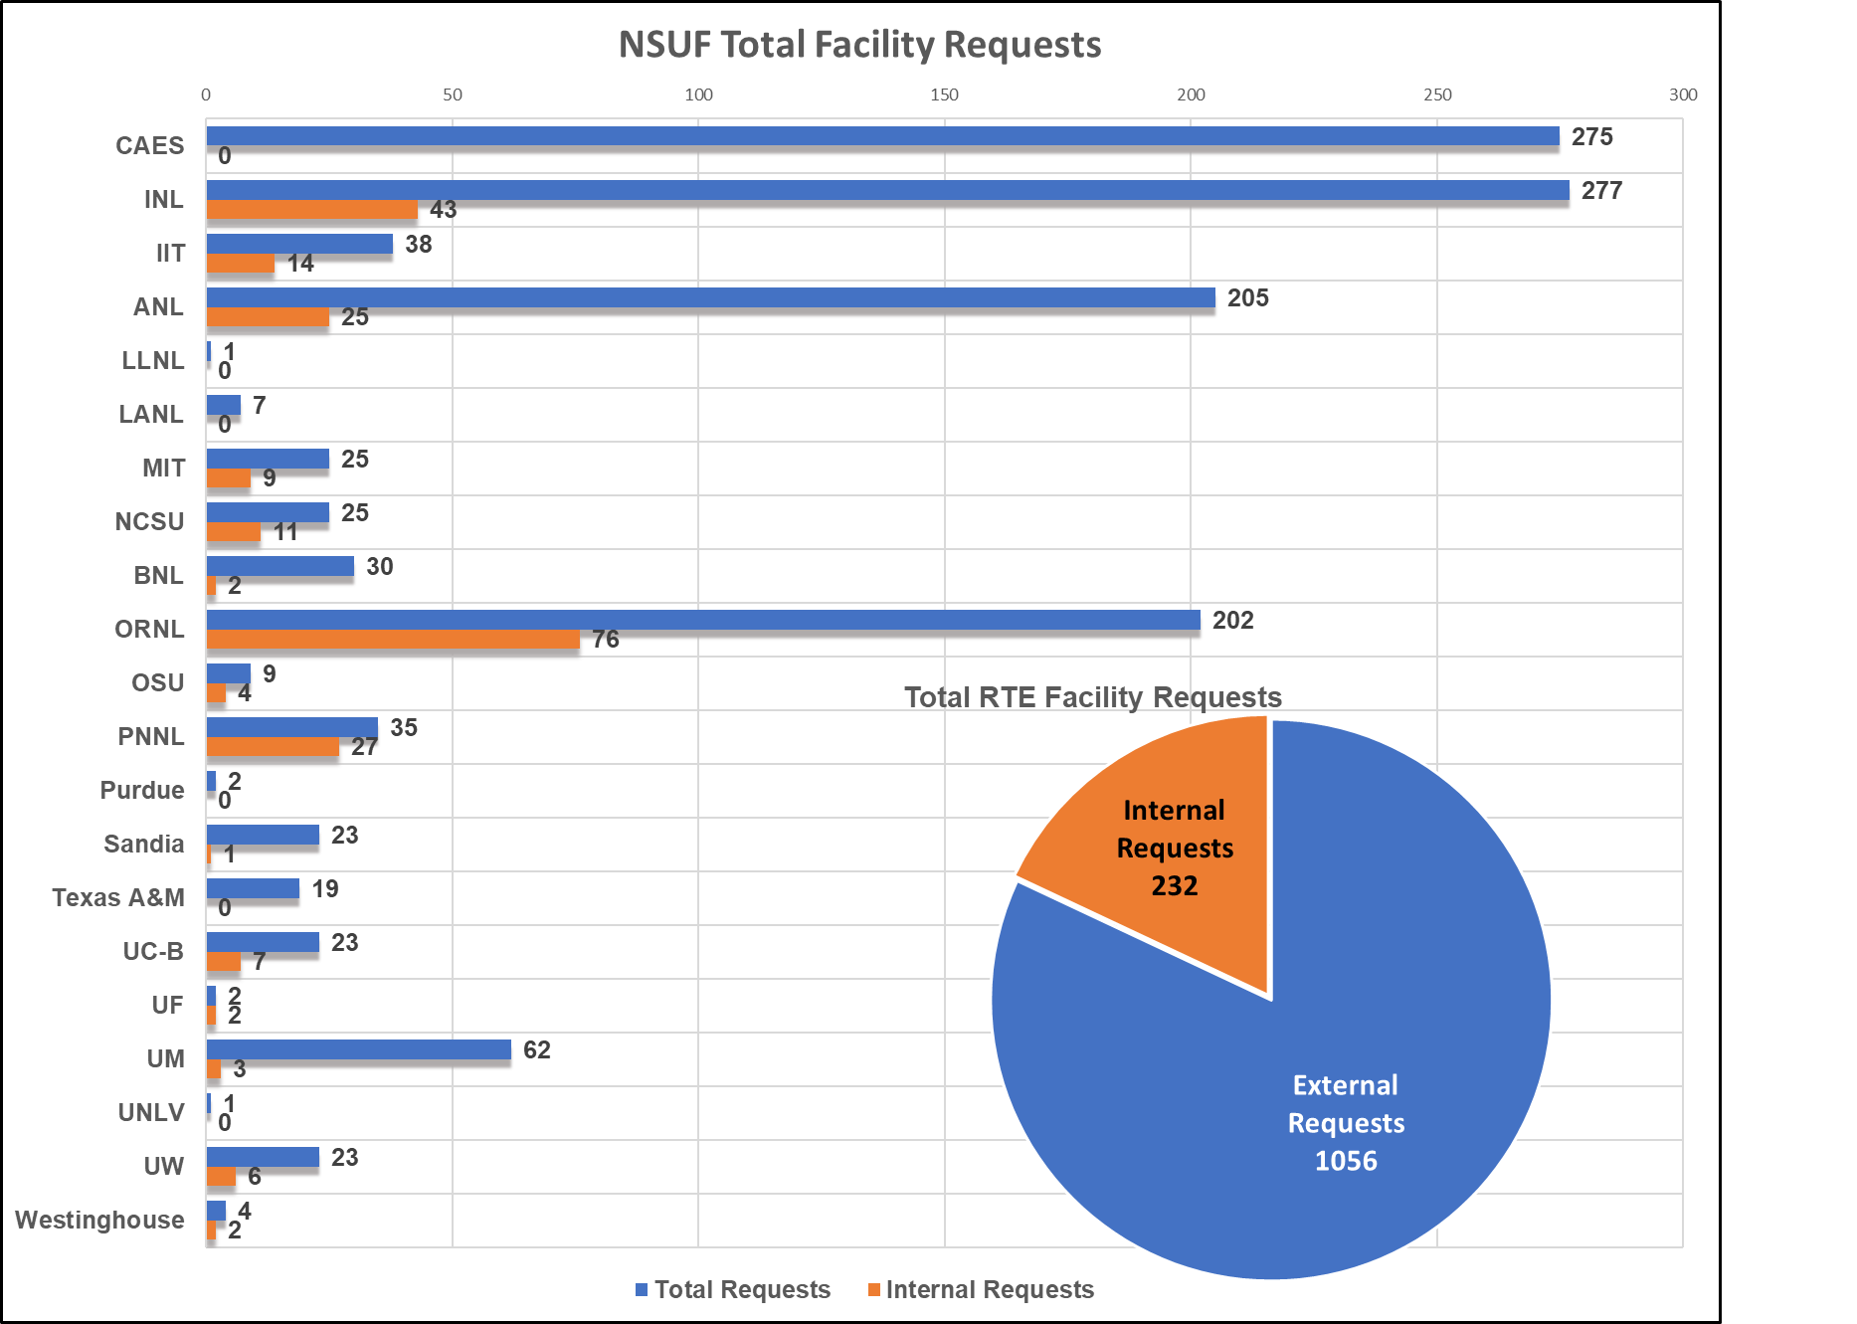
NSUF Facility Utilization
18%
Poor metric if large portion of applications from internal researchers.
Partner facilities need to control number of internal applications and engage external users.
Requests using “own” materials: consider adding to NFML.
Issue: R&D funds must be identified and independent of NSUF support.
Issue: NSUF work scope can not be part of ongoing program/project work scope.
Graphics created by Jeff Benson

Slide 37
Combined Materials Experiment Toolkit (CoMET)
Integrated Databases
Nuclear Energy Infrastructure Database (NEID) - 2015
Nuclear Fuels and Materials Library (NFML) - 2016
Nuclear Energy Researcher database (NERD) - 2018
NSUF Projects Database - 2020
Launched the Reactor Activation and Damage (RAD) Calculator
Coupled the Nuclear Experiment Wizard Expert System
NSUF workshop on the Wizard (9/2020)
Each box in the history represents a stage in the undertaking where a decision was made and/or information/data was input. At each stage of the undertaking, the user is offered access to additional reference data and information.
Multiple team members can all work on an undertaking at the same time, keeping all information in one place.
Wizard clearly communicates all relevant information needed for the decision or input required at each stage.

Slide 38
Quantifying the Impact of NSUF Fuels and Materials Understanding Scale (FaMUS)
³3₀
³4₁
³5₂
³6₃
Mechanistic
Understanding
²2₀
²3₁
²4₂
²5₃
Quantitative
¹1₀
¹2₁
¹3₂
¹4₃
Qualitative
Observation
Effect of 1 variable
Effect of 2 variables
Effect of 3 variables

Slide 39
FY 2021

Slide 40
FY 2021 Action Areas (CR Budget)
Execute awarded projects (CINR, pre-CINR, RTEs, CRADAs)
Irradiation coordination
PIE coordination
CINR (FY21 - $2.5M, FY20 - $4.1M, FY19 - $16M, FY18 - $10M, FY17 - $11M, FY16 - $10M, FY15 - $4.1M, FY14 - $400K)
60 LOIs (128 LOIs in FY20), 58 pre-applications (106 pre-applications in FY20), 15-20 full proposals (35 in FY20)
Rapid Turnaround Experiments: 1 call in FY21
Industry programs
Continue to emphasize CINR & RTE
Enhance mechanical testing and IASCC maintenance
Enhance NFML through interactions with commercial decommissioning
Application and refinement of FaMUS: determine NSUF impact
Nuclear Fuels and Materials Library (NFML)
Continue to improve web based interactive tools (CoMET).
Increase capacity and content including industry decommissioning, international sources, DOE programs, SAM series.

Slide 41
FY 2021 Action Areas (CR Budget)
Instrumentation / Scientist Support (reduced by >70%)
Support INL instrument scientists at up to 20% time to maintain instruments, develop/adapt/implement cutting edge techniques and maintain or establish international reputation
Communication / Training / Development / Expansion
Website development, newsletter, conference sessions, invited presentations, overview publications.
Expand beamline access and international cooperation/collaboration
APS – Activated Materials Laboratory (AML)
NSLS-II – XPD beamline
US – UK Action Plan (Working Group with NNUF)
Belgium Nuclear Research Center (BR2 & LMHA)
High Performance Computing
100% of cpu time on Falcon and Sawtooth machines available through NSUF - continue to offer and emphasize through CINR and RTE calls
Nuclear Materials Discovery and Qualification initiative (NMDQi)

Slide 42
FY 2021 Non-Action Areas (CR Budget)
Communication / Training / Development / Expansion
No Users Meeting, no Partners Meeting, no exhibits, no interns
Infrastructure and Capabilities Management
No NEID maintainance or expansion.
No Gap Analysis.
Combined Materials Experiment Toolkit (CoMET) is available but no further development/improvement.
No capabilities development or investment

Slide 43
FY 2021 Milestones (CR Budget)
1st Quarter (10/1/2020 – 12/31/2020)
3 Level 2 milestones
10 Level 3 milestones
2nd Quarter (1/1/2021 – 3/31/2021)
4 Level 2 milestones
15 Level 3 milestones
3rd Quarter (4/1/2021 – 6/30/2021)
5 Level 2 milestones
5 Level 3 milestones
4th Quarter (7/1/2021 – 9/30/2021)
4 Level 2 milestones
25 Level 3 milestones
1st Quarter (10/1/2021 – 12/31/2021)
0 Level 2 milestones
6 Level 3 milestones
16 Level 2 Milestones (12 in FY 2020)
61 Level 3 Milestones (59 in FY 2020)
86 Work Packages (75 in FY20)
Moved some Level 3 reports into 1st quarter FY2022 to attain more balanced milestone distribution.

Slide 44


